Slide 1
Labor_01
Linear Regression with one variable

Slide 2
Machine Learning
„The field of study that gives computers the ability to learn without being explicitly programmed.”
/Arthur Samuel/

Slide 3
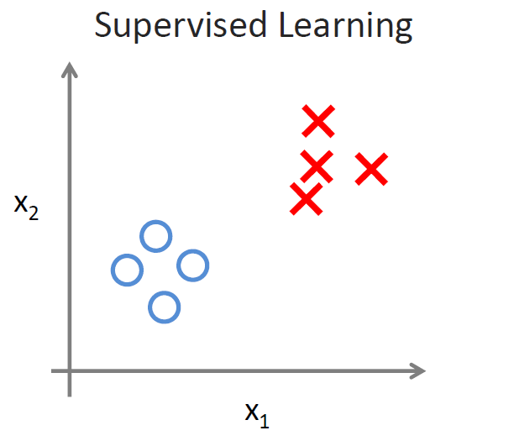
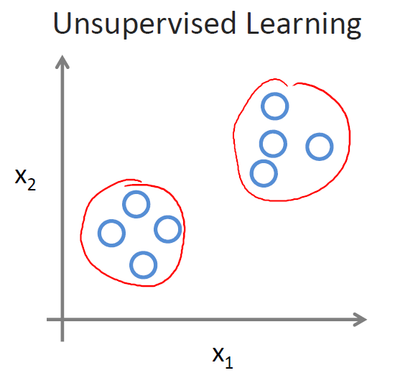
Main categories
Supervised learning
Unsupervised learning
Regression
Classification

Slide 4
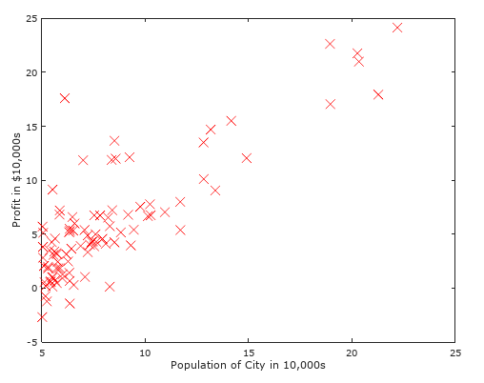
Linear Regression
One variable linear regression
You have data for profits and populations from different cities. You would like to use this data to help you select which city to expand your food truck company.

Slide 5
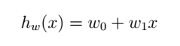
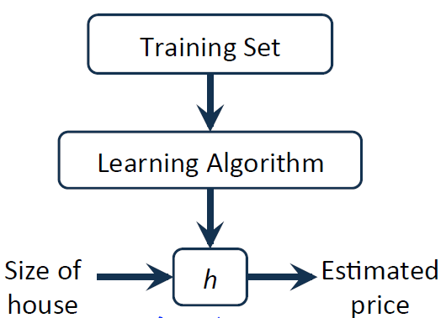
Model
Representation of h:
Size of City
Estimated profit

Slide 6
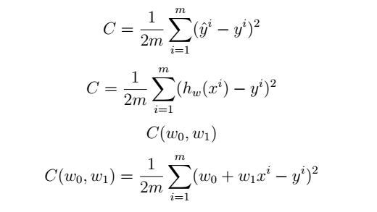
Cost function: MSE (Mean Squared Error)

Slide 7
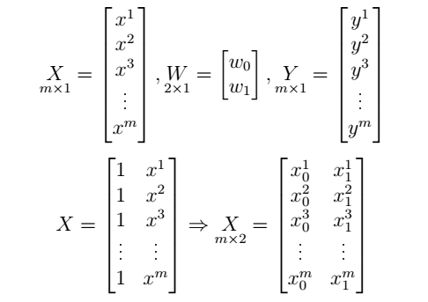
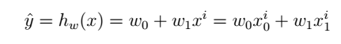
Data representations
Input data: X vector
Weights: W vector
Supervised output: Y vector
ADD +1 (BIAS) to X vector

Slide 8
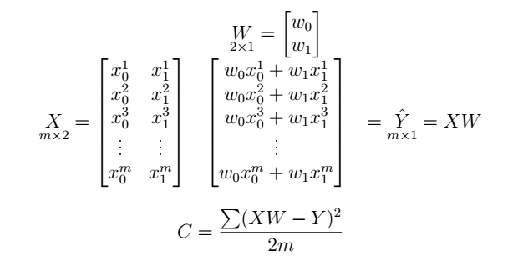
Forward step
Data set => Hypothesis => Cost function
Minimize the Cost function!

Slide 9
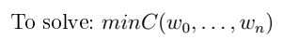
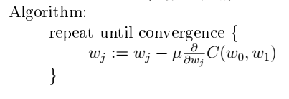
Gradient descent
Simultaneous update!!!

Slide 10
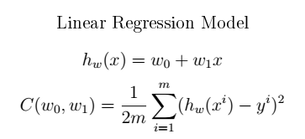
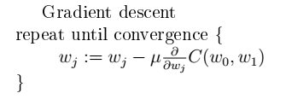
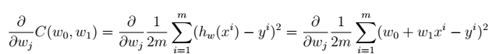
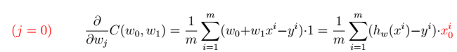

Linear Reg. + Grad. Descent

Slide 11
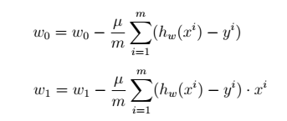
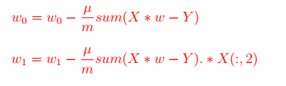
„Batch” Gradient Descent
Each step of gradient descent uses all the training examples

Slide 12
Labor_02
Linear Regression with multiple variable

Slide 13
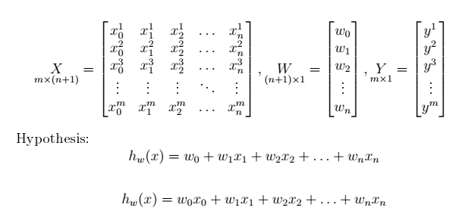
Hypothesis
Additional X0=1 (BIAS)
X*W

Slide 14
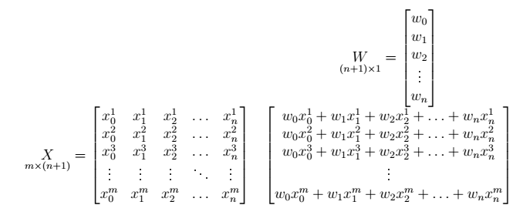
Estimation

Slide 15
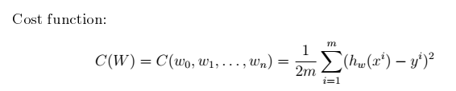
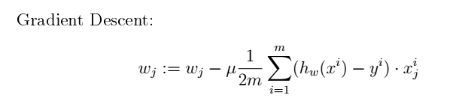
Cost and Grad
For j on features
j=0…n

Slide 16
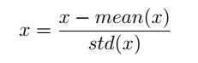
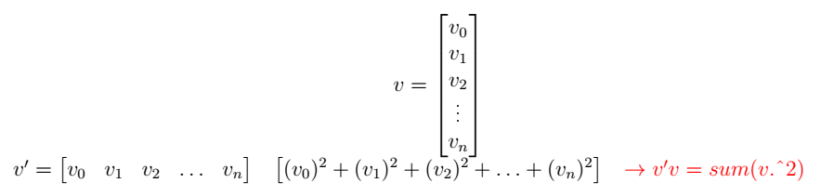
Data preparation
Feature Scaling
Mean Normalization
=> Faster convergence
HINT:

Slide 17
Labor_03
Logistic Regression Linear Case

Slide 18
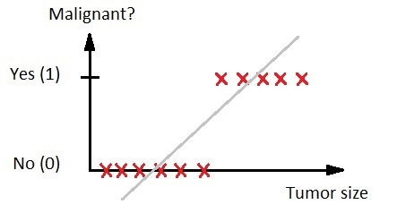
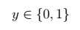
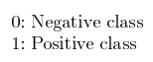
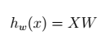
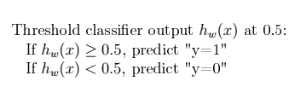
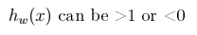
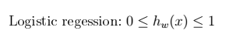
Classification problem

Slide 19
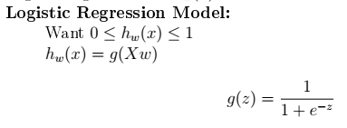
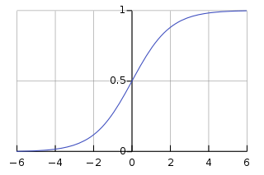
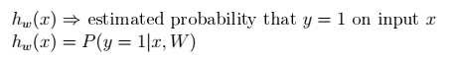

New Model

Slide 20
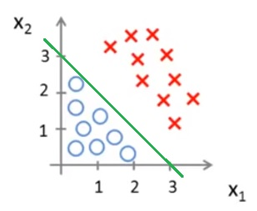
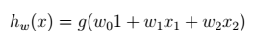

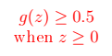

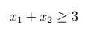
Example linear boundary

Slide 21
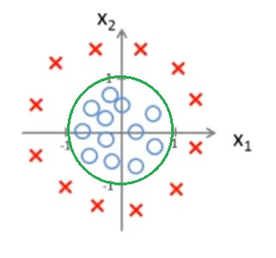
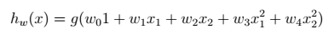
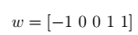


Example non linear boundary

Slide 22
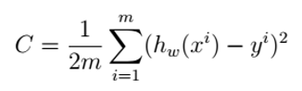
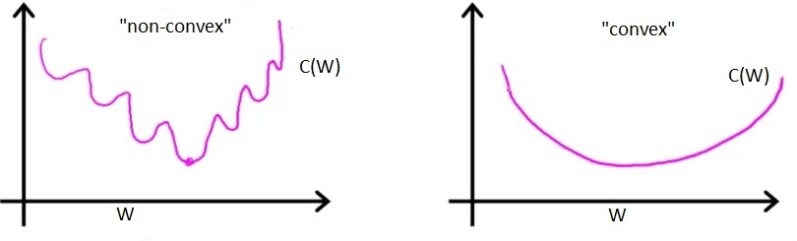
Cost function
?

Slide 23
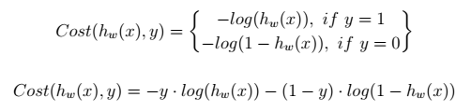
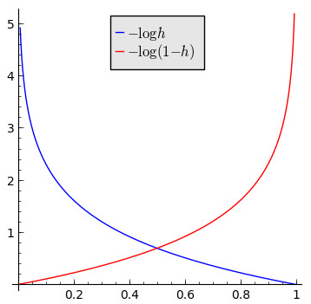
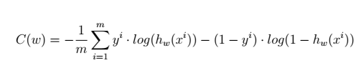
Cost function

Slide 24
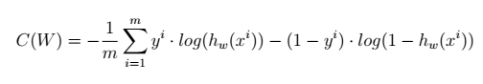
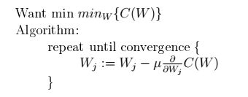
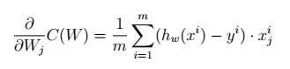
Gradient Descent
Algorithm looks identical to linear regression!

Slide 25
Labor_04
Logistic Regression non Linear Case

Slide 26
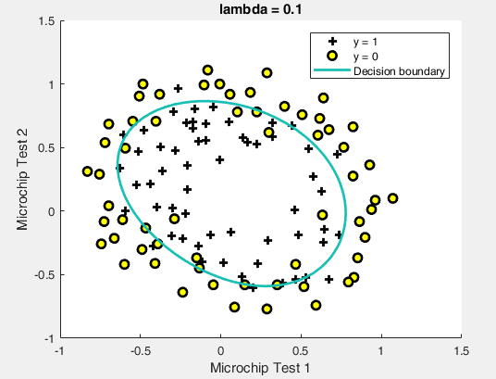
Non Linear Boundary

Slide 27

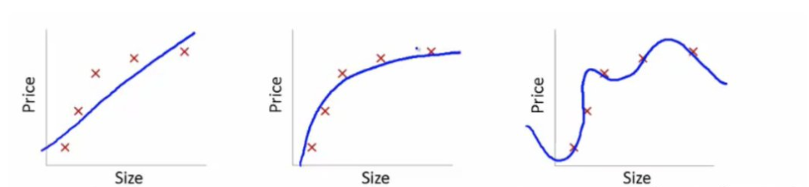



Polynomial features

Slide 28

Bias vs Variance

Slide 29
Problem
- Not enough feature: underfit
- Too many features: overfit
Solution:
Reduce number of features
Manually
Model selection
Regularization
Keep all the features, but reduce magnitude/value of weight
DO NOT PENALIZE THE BIAS!!!

Slide 30


Regularization

Slide 31


Regularized Logistic Regression

Slide 32




Cost function and derivative
Gradient Descent:
Zipped in: fmincg() or fminunc() function

Slide 33
Labor_05
Multi Class Classification

Slide 34

One vs All

Slide 35
Labor_06
Neural Networks Basics

Slide 36

Neural Network Model

Slide 37
Labor_07
Neural Network Train

Slide 38




Neuron

Slide 39






Neural Network: Forward Step

Slide 40

Neural Network: Cost function

Slide 41


Sigmoid and Derivate

Slide 42


Neural Network: Back Propagation

Slide 43

Neural Network: Training

Slide 44
Labor_08
Regularization

Slide 45
Practice
Rewrite code from previous lessons
Test different cases (learning rate, regularisation)

Slide 46


High Bias
Even training error is unacceptably high
Small gap between training and test error

Slide 47


High Variance
Even training error is small
Huge gap between training and test error

Slide 48
Tips
- Try getting more training example – fixes high variance
- Try smaller sets of features – fixes high variance
- Try getting additional features – fixes high bias
- Try additional polynomial features (x^2, x1x2…) – fixes high bias
- Try decrease λ – fixes high bias
- Try increase λ – fixes high variance

Slide 49
Labor_09
Support Vector Machine

Slide 50

SVM idea

Slide 51


Support Vector Machine

Slide 52





Cost function – Logistic Regression

Slide 53



Cost Function - SVM

Slide 54


Gaussian Kernel

Slide 55
Labor_10
Spam email classification

Slide 56
processEmail.m
- Lower-casing
- Stripping HTML
- Normalizing URLs
- Normalizing Email Addresses
- Nurmalizing Numbers
- Normalizing Dollars
- Word Steamming („include”, „includes”, „included” -> „includ”)
- Removal of non-words

Slide 57

preprocessEmail.m

Slide 58

Vocabulary List
The next step is to choose which words we would like to use in our classifier and which we would want to leave out.
Convert each email into a vector. Specifically whether the i-th word in the dictionary occurs in the email.:

Slide 59
Labor_11
K-Means algorithm

Slide 60

Unsupervised learning

Slide 61

K-Means Algorithm example

Slide 62

K-Means Algorithm example

Slide 63

K-Means Algorithm example

Slide 64

K-Means Algorithm example

Slide 65

K-Means Algorithm example

Slide 66

K-Means Algorithm example

Slide 67

K-Means Algorithm example

Slide 68

K-Means pseudocode

Slide 69

Random initialization

Slide 70

Local optimum

Slide 71

What is the right number of K?

Slide 72

Choosing K

Slide 73

Choosing K

Slide 74
Labor_12
Principal Component Analizis

Slide 75

Data compression

Slide 76

Data compression

Slide 77

Data compression

Slide 78

PCA

Slide 79

PCA is not Linear Regression

Slide 80

Data preprocessing

Slide 81


PCA algorithm

Slide 82

PCA algorithm

Slide 83

PCA summary

Slide 84

Reconstruction from crompressed reprezentation

Slide 85

Choosing k

Slide 86

Application

Slide 87

Bad use of PCA: prevent overfitting

Slide 88
Labor_13
Anomaly Detection

Slide 89
Labor_14
Recommender system

